Slide 1
Ice Age
Notes:
1

Slide 2
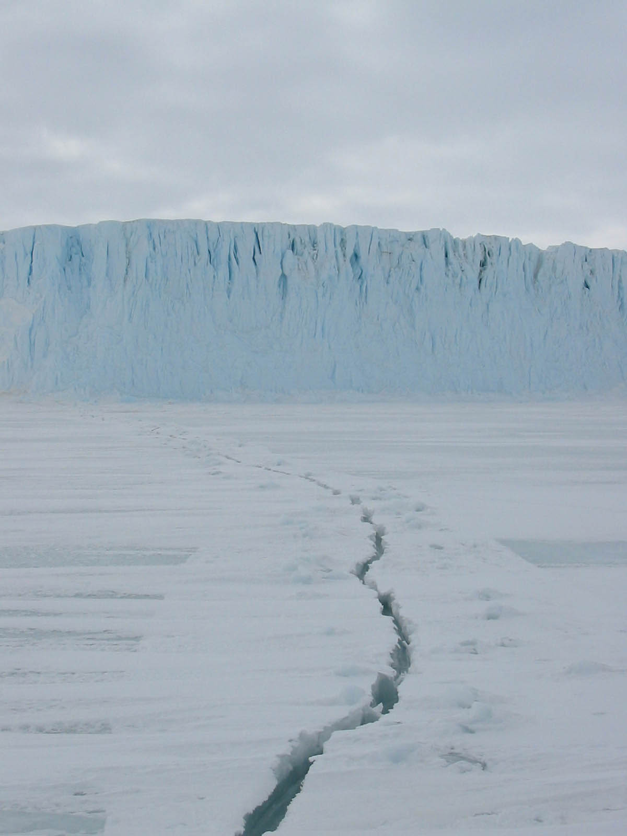
The First Americans
• Approximately 30,000 years ago the earth experienced an Ice Age.
• Ice Age – a period of time in which temperatures on earth were very cold, and North America was covered in glaciers.
• Glaciers – large, slow moving sheets of ice
Notes:
2

Slide 3
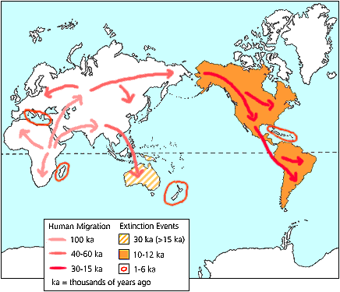
Some scientists believe that the first Homo Sapiens made their way to North American about 40,000 years ago.

Slide 4
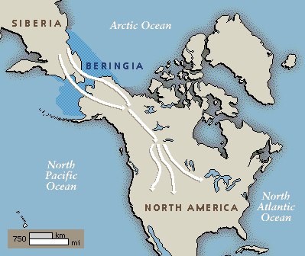
Notes:
4

Slide 6
10,000 - 8,000 BC

Slide 7
Paleo-Indians
Ancestors of North and South American’s native people
Came to America from Asia in search of food
Followed big game animals such as wooly mammoths, mastodons, caribou, and moose
These animals traveled far in search of grasslands - grazing across northern China and into Siberia and eventually crossing the Bering Strait.

Slide 8
Cultural Periods in Georgia History: Paleo
Paleo (from Greek, “Very Old”)
Also called Old Stone Age
10,000-8000 B.C.
Notes:
8

Slide 9
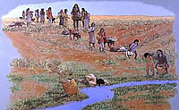
Nomadic (Roaming) Hunters
Notes:
9

Slide 10
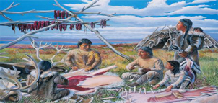
Band
25 – 50 People
Notes:
10

Slide 11
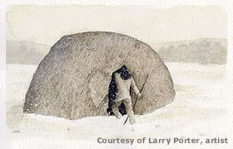
Notes:
11

Slide 12
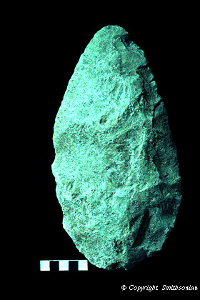
Most tools
and spear
points made
of stone
Notes:
12

Slide 13
Clovis and related projectile points from this time period
have been found throughout Georgia.

Slide 14
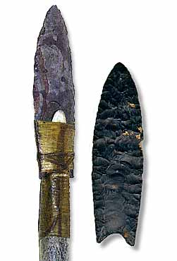
Clovis
Point
Notes:
14

Slide 15
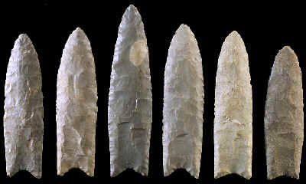
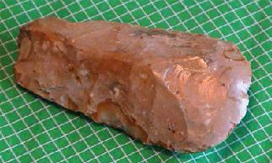
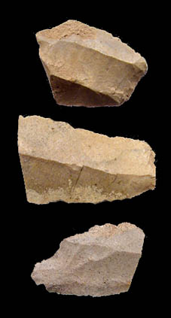
Clovis points, along with a number of other stone tools, found at Macon Plateau were the first Paleoindian points unearthed in eastern North America.

Slide 16
Food
Giant Sloth
Mammoth
Notes:
16

Slide 17
Notes:
17

Slide 18
Paleo
Dates | 10,000 – 8,000 B.C.
Weapons | Heavy Spears with Clovis Points, Atlatl
Food | Bison, Mastodons, Giant Sloths, Other Large Mammals, Small Game, Berries, Fruit, Vegetables
Dwellings | Non-Permanent Pits or Brush Covered with Hides or Bark
Evidence of Religion | Burial of Dead with Artifacts
Notes:
18

