Slide 1
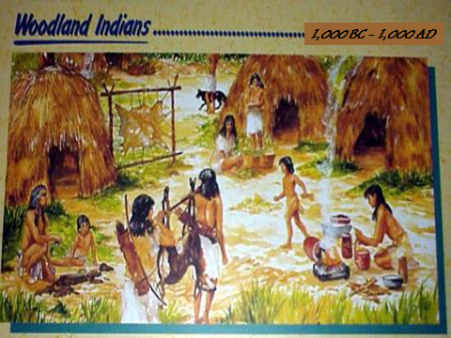

Slide 2
Woodland Period
Began when populations began growing in this area around 1,000 BCE
People were nomadic hunter-gatherers (tribes moved from place to place on an annual cycle) – tribes are groups of people who share common language, customs, and territory.
In good locations, small villages would start
Practiced agriculture (practice of growing specific plants for food); mostly grew maize, beans, and squash. These three crops were known as the Three Sisters of Native American agriculture.

Slide 3
Cultural Periods in Georgia History: Woodland
1,000 B.C. to 1,000 A.D.
Tribes
Shelter
Tools
Food
Pottery
Religion
Notes:
3

Slide 4
Tribes
group of people
sharing common ancestry,
name, and way of living
Notes:
4

Slide 5
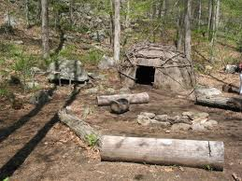
Eastern Woodland Indian Home
Built their homes of wattle and daub – a wooden frame covered with reed mats and plaster

Slide 6
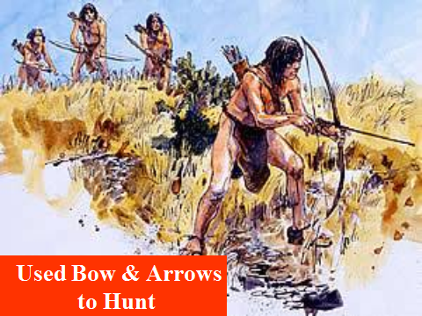
Notes:
6

Slide 7
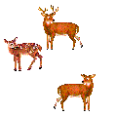
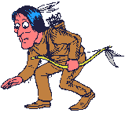
Hunted large animals
and small game
Notes:
7

Slide 8
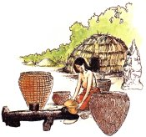
Improved
Pottery
Notes:
8

Slide 9
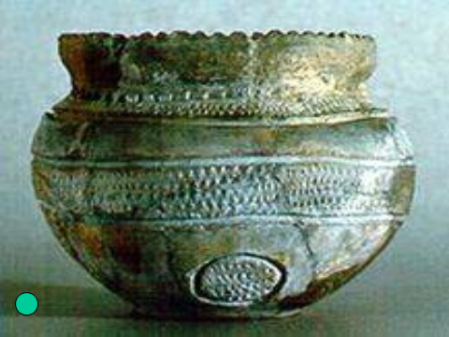
Notes:
9

Slide 10
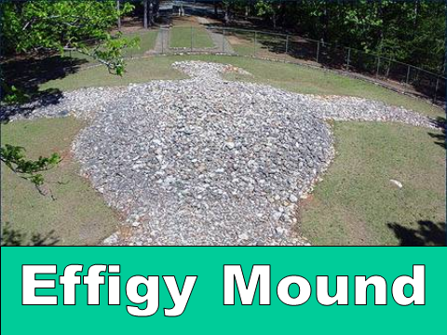
Notes:
10

Slide 11
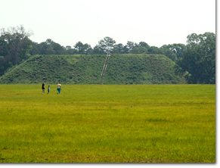
Kolomoki Mounds
Located in Southwest Georgia
Largest Woodland Settlement in State
Contained at Least 8 Mounds

Slide 12
Eastern Woodland Families
Women held a lot of power in the Woodland culture
Basic social unit was an extended family in which all the women were related
Children were seen as belonging to the mother, not the father

Slide 13
Woodland
Dates | 1,000 B.C. – 1,000 A.D.
Weapons | Bow and Arrow
Food | Deer, Small Game, Nuts and Seeds, Squash and Gourds
Dwellings | Sturdy Houses in Villages
Evidence of Religion | Burial Mounds, Some with Ceremonial Objects
Notes:
13

